Slide 1
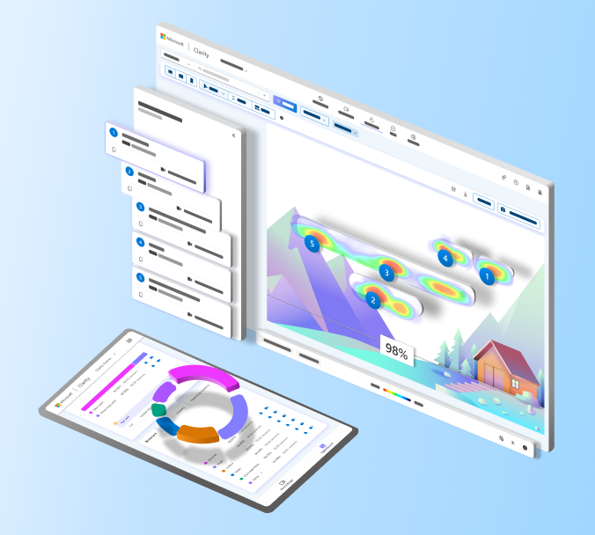
Microsoft Clarity

Slide 2
Introduction
Clarity is a user behavior analytics tool that helps owner to understand how users interact with his website
Features:-
Session Recordings- It allows owner to see how users navigate and interact with the website. These recordings can help to identify user behaviors, problems, and areas for improvement.
Heatmaps: The service generates heatmaps that visually represent where users are clicking on our website which area of website users are visiting more or scrolling more . This can be valuable in understanding which areas of pages are getting the most attention.
ML Insights Dashboard: Clarity offers an insights dashboard that provides a summary of key metrics such as User overview, Insights, Watchlist, Events, Browser etc and trends related to user engagement on website.
Insights contains features like:-
Rage click
Dead clicks
Excessive Scrolling
Quick Backs
User Feedback: Clarity also provides a feature for users to leave feedback directly on your website.

Slide 3
How it captures User Interaction?
Microsoft Clarity captures user interaction on web pages through the use of tracking scripts that you embed on your website.
To use Microsoft Clarity, we need to integrate a specific tracking script into the HTML code of your website. This script is provided by Clarity when we set up our account.
Once the tracking script is added to our web pages, it collects data about user interactions in real-time as visitors navigate through our site. The script captures information such as clicks, mouse movements, scrolls, and other interactions.
Heatmaps and Dashboard take time to load in starting for showing the result because it take time to analyze.

Slide 4
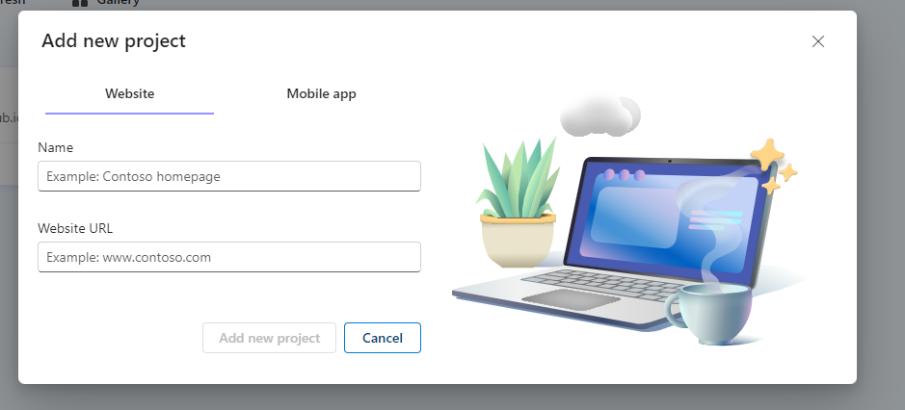
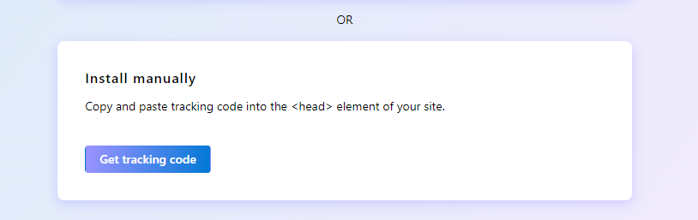
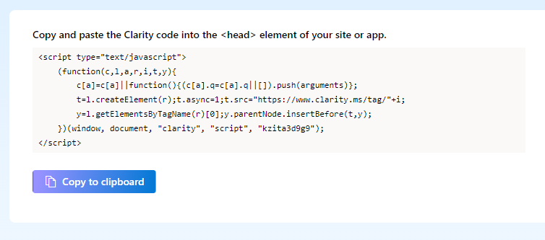
How to setup?
Enter the name and provide the website URL
Choose Install manually
Copy and paste the clarity code in the HTML head tag

Slide 5
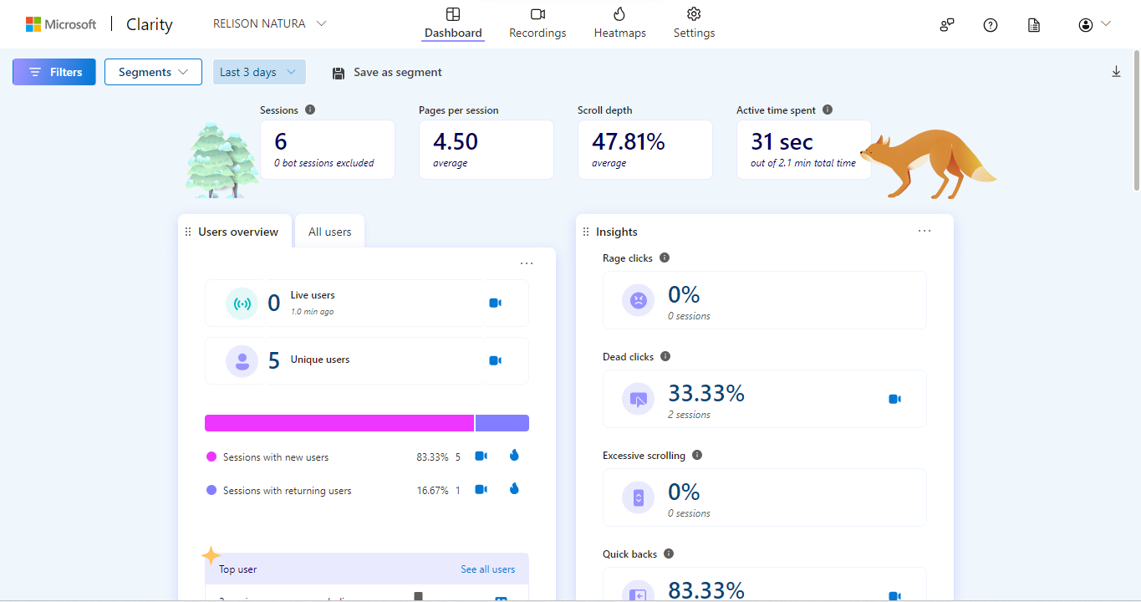
After Setting UP
Dashboard

Slide 6
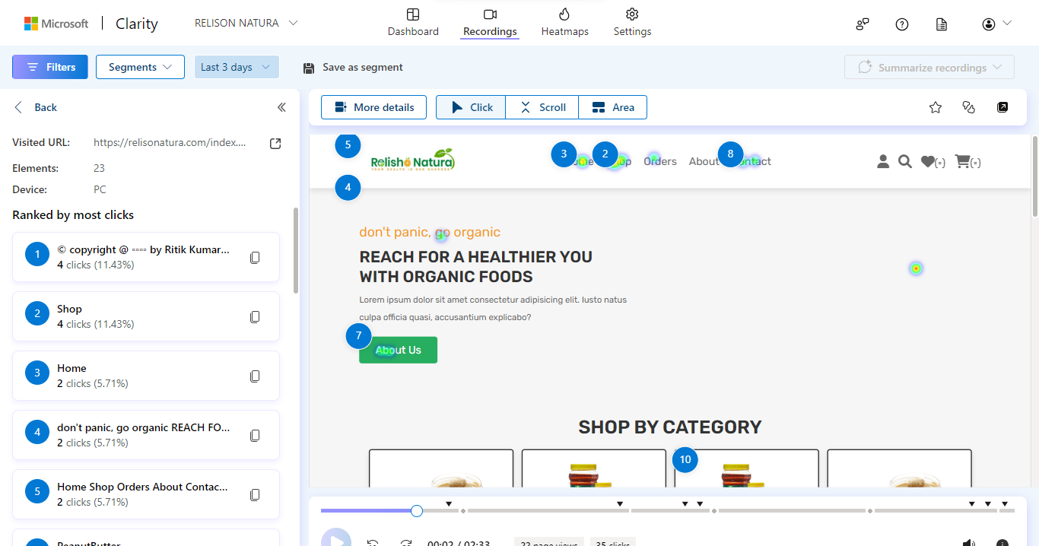
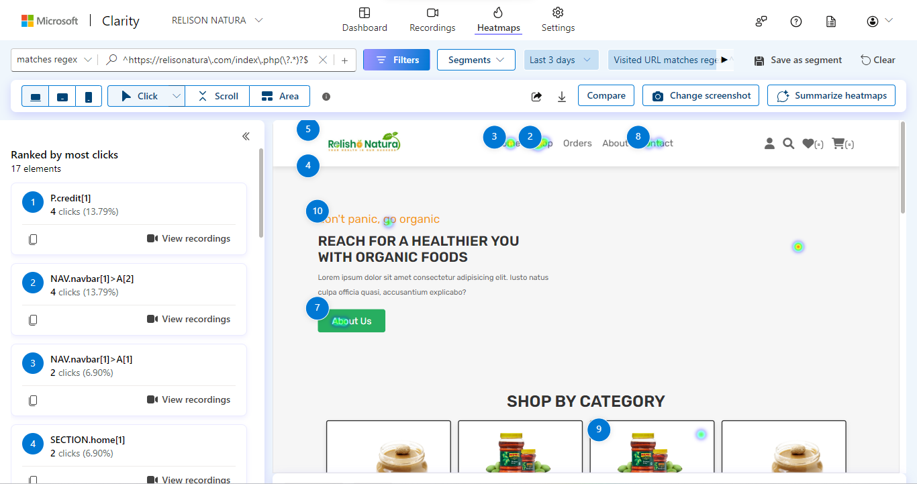
Recordings
Heatmaps

Slide 7
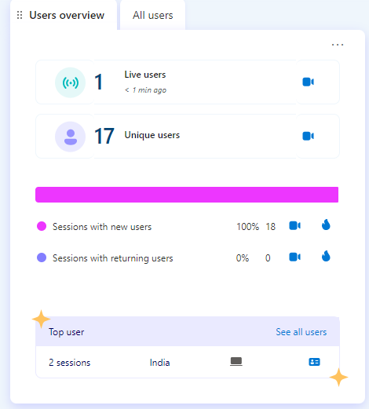
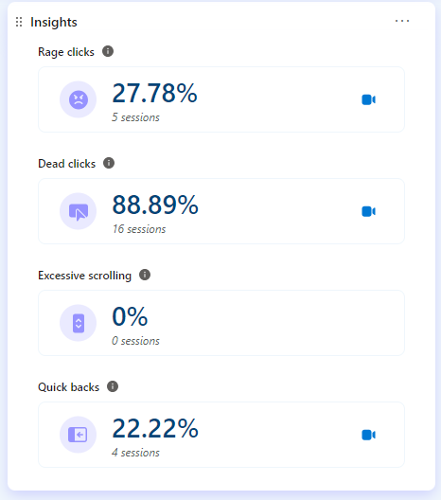
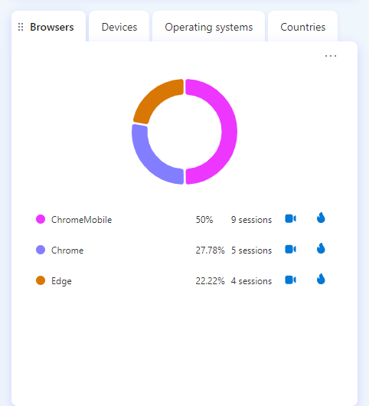
Data Analyzation
I use this CSS-Assignment5 (subhg.github.io)site for analyzing data :-
Here are the
User overview:-
18 Unique user from India
Insights:-
Rage clicks-27.78%
Dead clicks-88.89%
Excessive Scrolling-0%
Quick backs-22.22%
Browsers Use:-
Chrome-27.78% 5 sessions
Chrome Mobile- 50% 9 sessions
Edge-22.22% 4 session

Slide 8
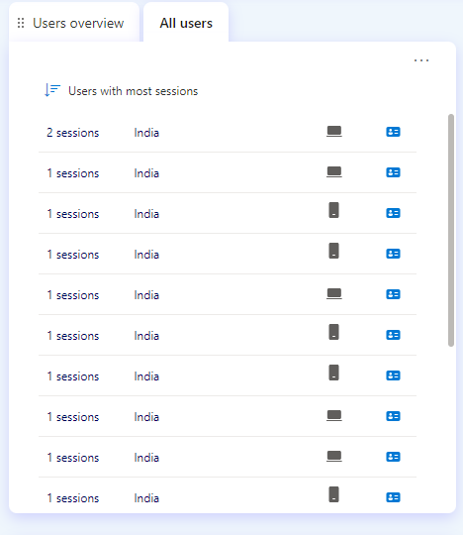
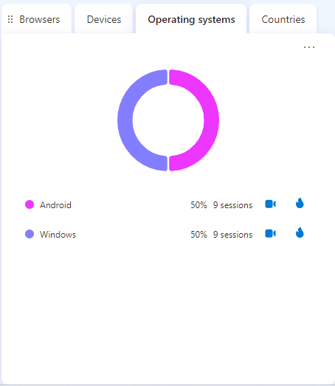
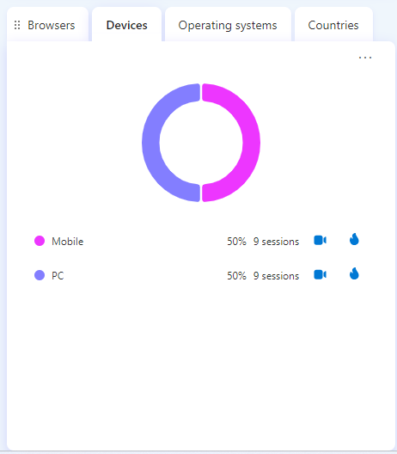
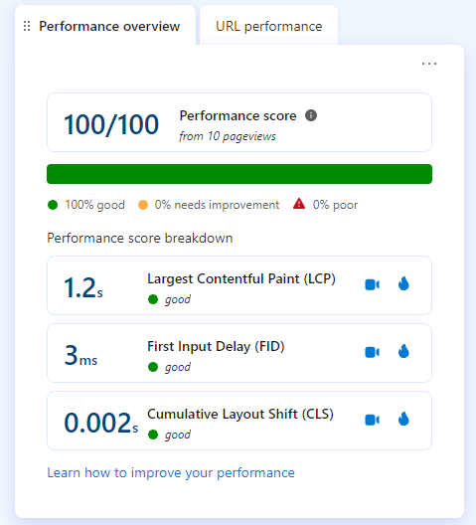
Operating system- Android- 50% & 9 sessions
Windows-50% & 9 sessions
Devices- Mobile- 50% & 9 sessions
PC- 50% & 9 sessions
Performance Overview- 100/100
All users-India

Slide 9
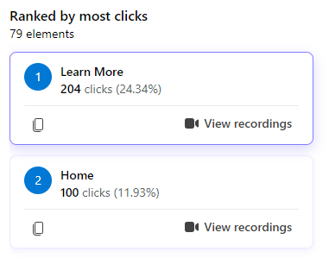
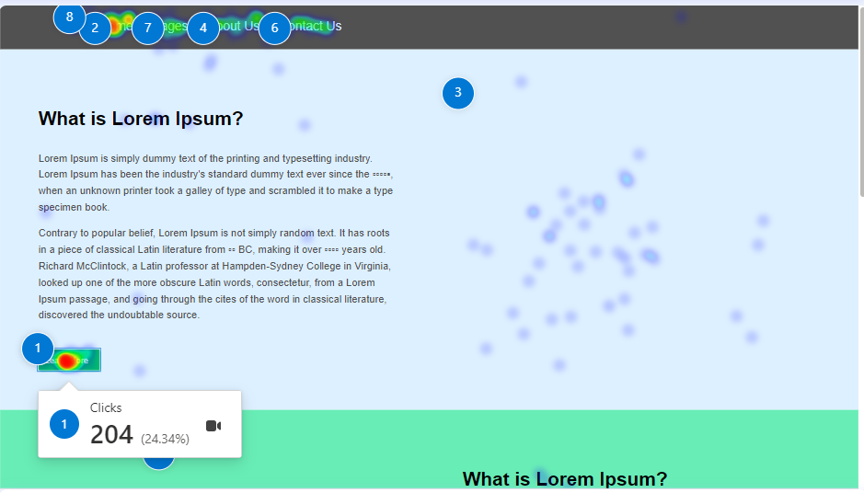
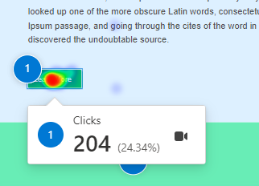
Features and button Receive the Most Click
The most clicked features buttons are:-
Learn more button-204 clicks
Home button-100 clicks

Slide 10
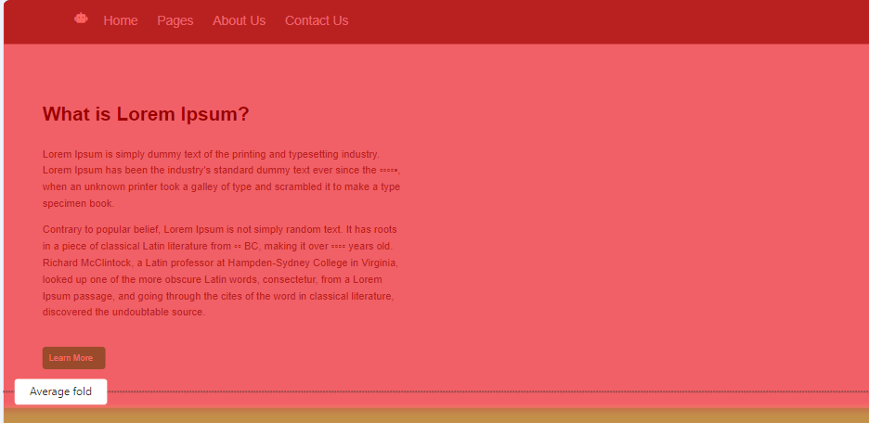
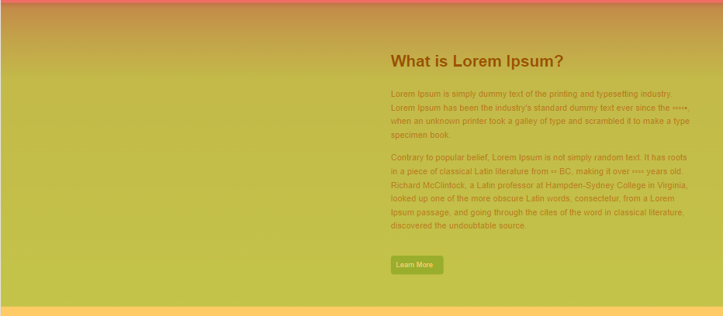
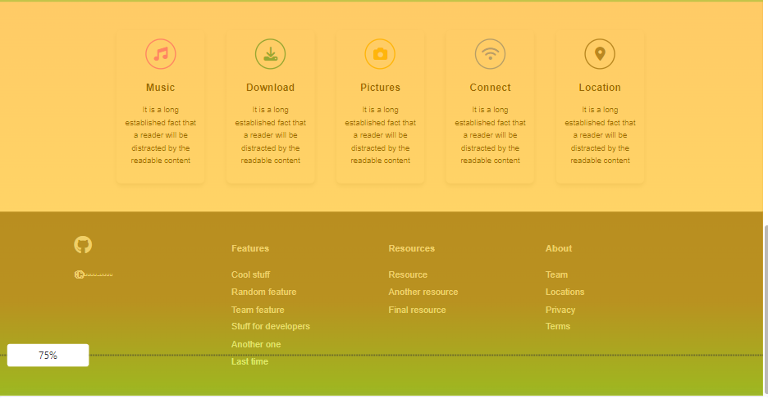
User Behavior
Users on desktop devices scrolled down the page until the end, with a slight drop-off at 35% and 95% scroll depth.
Users on desktop devices clicked mostly on the Home and About Us links in the main menu, and on the Learn More button in the hero section.
Users on desktop devices also clicked repeatedly on the Home link, indicating frustration or confusion, and on some text and image elements that are not clickable, such as the Music and Pictures sections.
Users on mobile devices scrolled down the page until the end, with a significant drop-off at 90% and 100% scroll depth.
Users on mobile devices clicked mostly on the Mobile menu icon and the Hero section, and on some text elements that are not clickable, such as the Music section.
Users on mobile devices also clicked repeatedly on the Hero section, indicating frustration or confusion, and on an empty element [?hash=1951m96yh], suggesting a possible error or bug.
Users on tablet devices did not visit or interact with the page at all, suggesting a lack of interest or compatibility.
100% users - Scrolling
81.48% users - Scrolling
75% users - Scrolling

Slide 11
Optimization we Can do:-
To improve the user experience and engagement:-
The website could use more clear and consistent call-to-action buttons, such as Final resource and Cool stuff, and avoid using text and images that look like links but are not clickable, such as the Music and Pictures sections.
To showcase the website's features and benefits, the website could use more compelling and relevant content, such as testimonials, case studies, or videos, and avoid using filler text, such as "It is a long established fact that a reader will be distracted by the readable content".
To optimize the website for mobile devices, the website could use a responsive design that adapts to different screen sizes and orientations, and fix any errors or bugs that may prevent users from accessing or clicking on certain elements.
To increase the website's reach and visibility, the website could use more effective marketing strategies and channels to attract and retain tablet users, such as social media, email, or ads, and ensure that the website is compatible and accessible on different browsers and devices.

Slide 12
Final Report
User Overview:
18 unique users from India.
Insights:
Rage Clicks: 27.78%
Dead Clicks: 88.89%
Excessive Scrolling: 0%
Quick Backs: 22.22%
Browsers Used:
Chrome: 27.78% (5 sessions)
Chrome Mobile: 50% (9 sessions)
Edge: 22.22% (4 sessions)
Operating System (All Users - India):
Android: 50% (9 sessions)
Windows: 50% (9 sessions)
Devices:
Mobile: 50% (9 sessions)
PC: 50% (9 sessions)
Performance Overview:100/100
Most Clicked Features:
Learn More Button: 204 clicks
Home Button: 100 clicks
User Behavior - Desktop:
Scroll Depth: Reached end with a slight drop-off at 35% and 95%.
Clicked mostly on Home and About Us links in the main menu and Learn More button in the hero section.
Repeated clicks on Home link and non-clickable elements like Music and Pictures sections.
User Behavior - Mobile:
Scroll Depth: Reached end with a drop-off at 90% and 100%.
Clicked mostly on Mobile menu icon, Hero section, and non-clickable elements like Music section.
Repeated clicks on Hero section and an empty element [?hash=1951m96yh], suggesting a possible error or bug.
User Behavior - Tablet:
No visits or interactions, suggesting a lack of interest or compatibility.

Slide 13
Thank you!!!

